Slide 1
CSE 3216: Software Design Patterns
Introduction

Slide 2
What is Design Pattern
Design patterns represent the best practices used by experienced object-oriented software developers
Design patterns are solutions to general problems that software developers faced during software development.
These solutions were obtained by trial and error by numerous software developers over quite a substantial period of time.

Slide 3
Types of Design Patterns
Creational Design Patterns: These design patterns provide a way to create objects while hiding the creation logic, rather than instantiating objects directly using new operator. This gives program more flexibility in deciding which objects need to be created for a given use case.
Structural Design Patterns: These design patterns concern class and object composition. Concept of inheritance is used to compose interfaces and define ways to compose objects to obtain new functionalities.
Behavioral Design Patterns: These design patterns are specifically concerned with communication between objects.

Slide 4
Creational Design Patterns
Factory (Hide creation logic, refer using interface)
Abstract Factory (Factory of factories)
Singleton (Single Object Creation)
Builder (Builds the final object step by step)
Prototype (Creates prototype of an object)

Slide 5
Structural Design Patterns
Adapter (Works as a bridge between two incompatible interfaces)
Bridge (Works as a bridge between abstraction and implementation classes)
Filter (To filter a set of objects)
Composite (to treat a group of objects in a similar fashion)
Decorator (decorate existing object with new functionalities, not changing the signature class)
Facade (Hides complexities of the system and gives interface)
Flyweight (Reduces number of objects to decrease memory and improve runtime)
Proxy (Class representing behaviour of another class)

Slide 6
Behavioral Design Patterns
Chain of responsibility (Creates a chain of receiver object for a request)
Command (Data driven, request wrapped under an object as command)
Interpreter (To evaluate expression, grammar)
Iterator (Accessing a set of sequential objects not knowing underlying representation)
Mediator (To reduce communication complexity)
Memento (Persistence quality of backtrack)
Observer (In One-to-many relationships, an object is changed, the dependent objects need to be notified)
State (To handle different states)

Slide 7
Behavioral Design Patterns
Null Object (To check null)
Strategy (Objects representing strategies, context object changes behavior based on the strategy/object)
Template (Template abstract class with its different implementation by extended classes
Visitor (Visitor class, changes behaviour of an element class)

Slide 8
Architectural Design Patterns
Mode(Data), View(Visuals), Controller(Like between model and view)
Business Delegate (To separate business and presentation codes)
Composite (Objects are represented as graphs and their inbetween connection is maintained)
Data Access Object (To separate low and high level data maintenance)
Front Controller (Single server based system)
Intercepting Filter (To conduct some pre-processing or post processing)
Service Locator (To locate services)
Transfer Object (How to transfer object with multiple attributes)

Slide 9
Basics of Object Oriented Principles
Abstraction
To hide what is happening underneath
Public Interface, private implementation
Inheritance
Abstracting a class and its definition, extend it to use its functionality
To increase reusability
Encapsulation
Setting public, private to have access control
Polymorphism
Dynamic runtime behaviour of different functionalities in different objects
Follow dependency inversion

Slide 10
Chapter 1. Intro to Design Patterns
(Strategy Pattern)

Slide 11
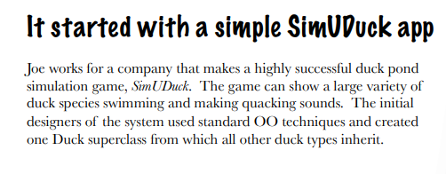
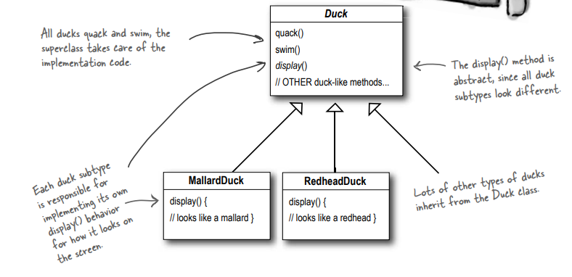
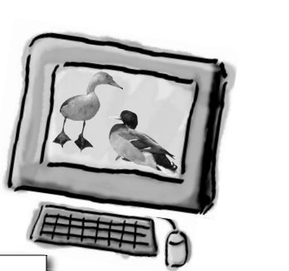
Arrow means (Extends)
Solution focusing on reusability(Applying inheritance)

Slide 12
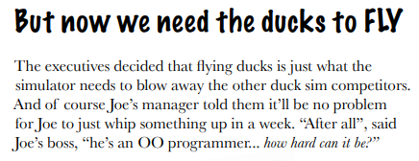
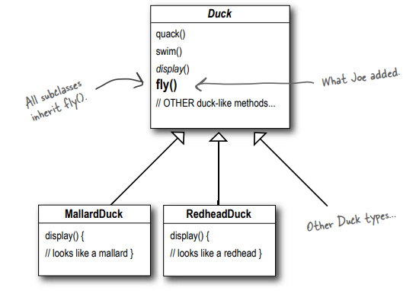
New Challenge Appears !

Slide 13
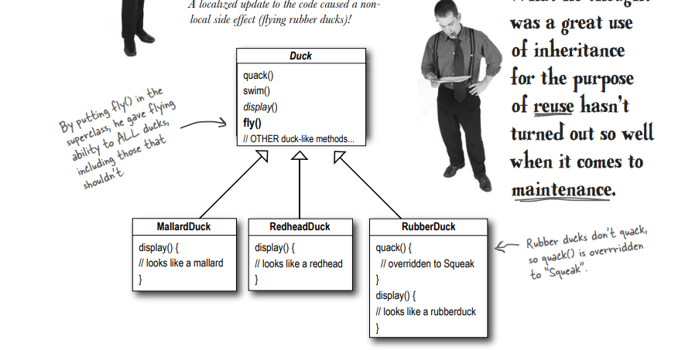
But it creates a problem.

Slide 14
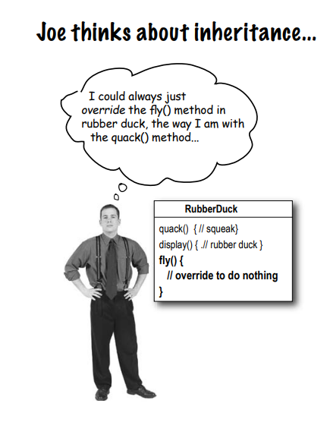
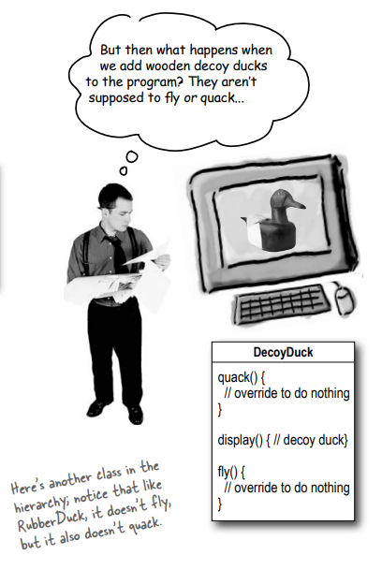
But the issue persists.
A possible solution

Slide 15
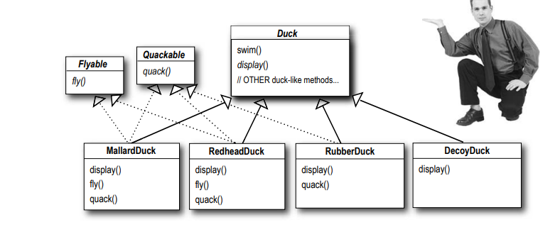
Solution using Interface
Issues:
- > Lost Reusability, need to implement each interface each time
-> Brings difficulties in code maintenance

Slide 16
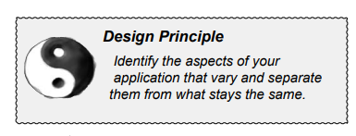
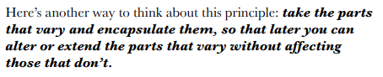
First Design Principle

Slide 17
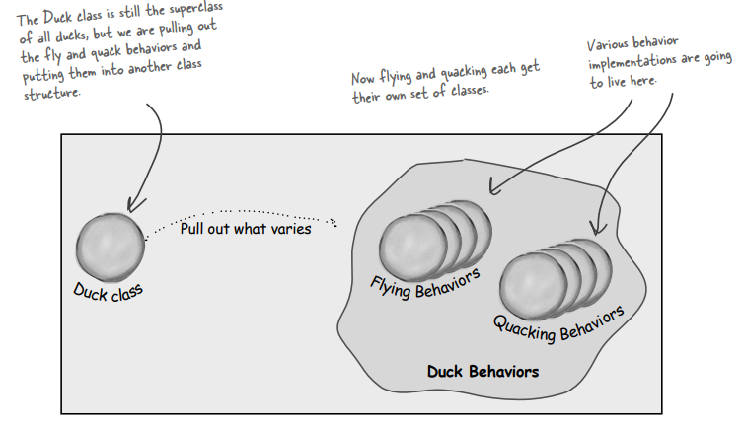
Putting flying and quacking to different classes

Slide 18
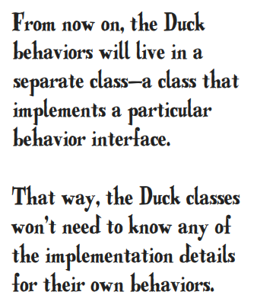
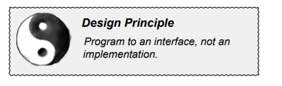
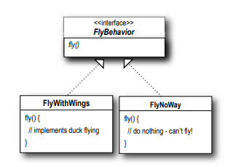
Second Design Principle
Helps to add new behaviour on the fly

Slide 19
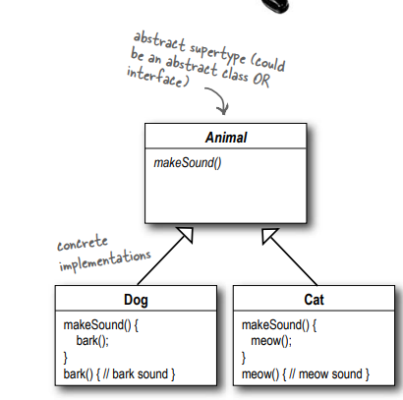
Program to an interface == Program to a supertype
To implement the supertype, we can either use Interface or Abstract classes

Slide 20
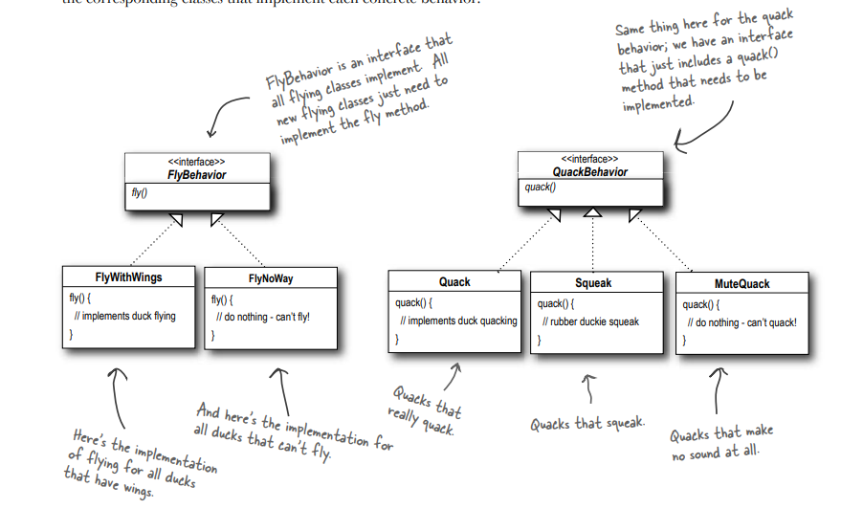
Implementing the duck behaviour

Slide 21
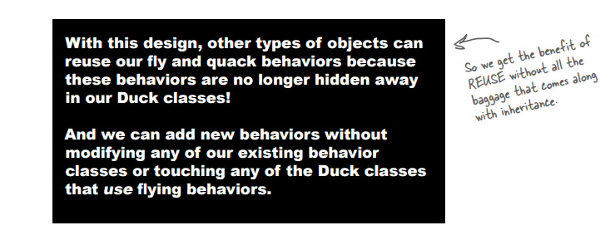
The Core Advantage/Benefit

Slide 22
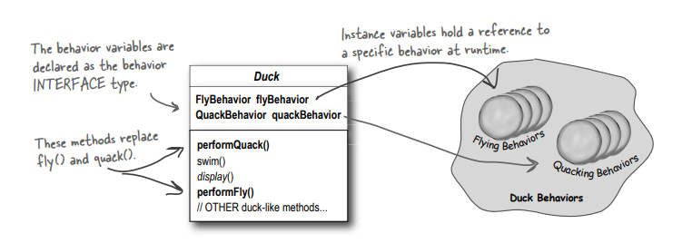
Integrating the duck behaviour
1. First we’ll add two instance variables

Slide 23
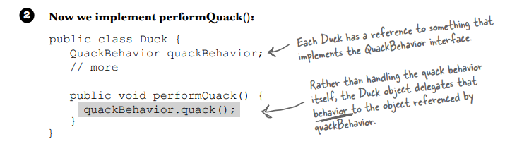

Slide 24
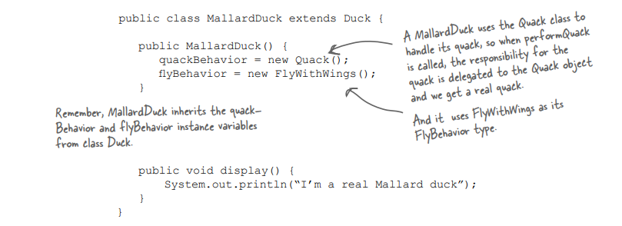
3. how the flyBehavior and quackBehavior instance variables are set

Slide 25
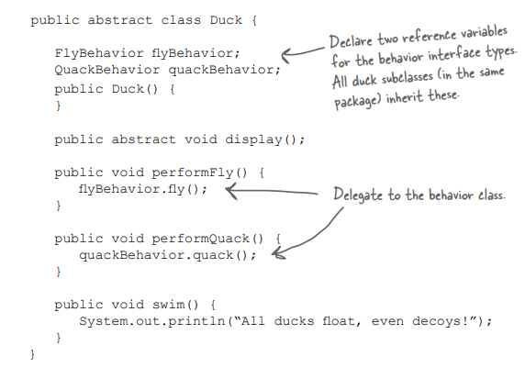
Testing the Duck code - 1

Slide 26
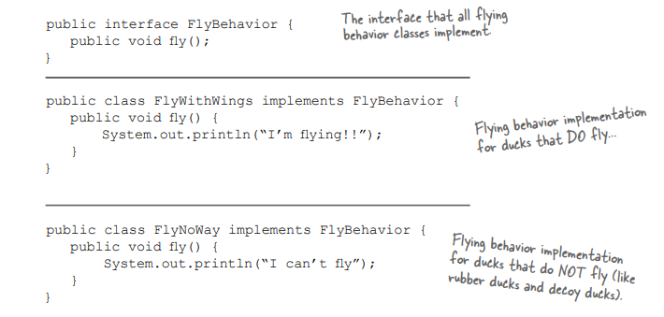
Testing the Duck code - 2

Slide 27
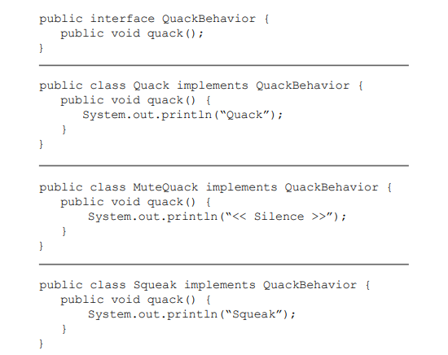
Testing the Duck code - 3

Slide 28
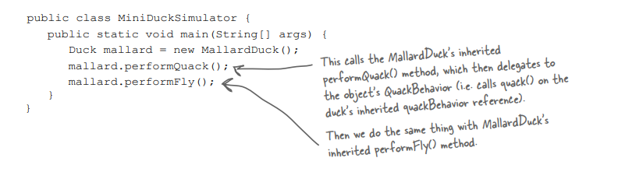
Testing the Duck code - 4

Slide 29
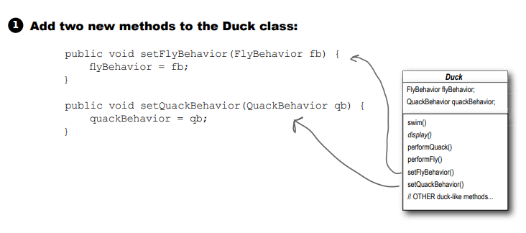
Setting Behaviour Dynamically - 1
We can call these methods anytime we want to change the behavior of a duck on the fly.

Slide 30
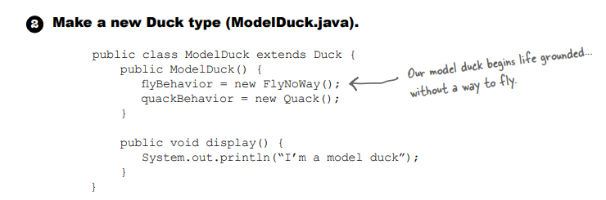
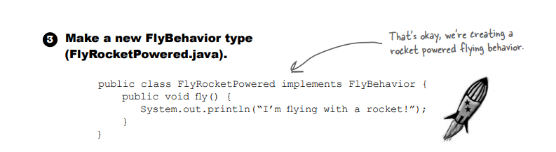

Slide 31
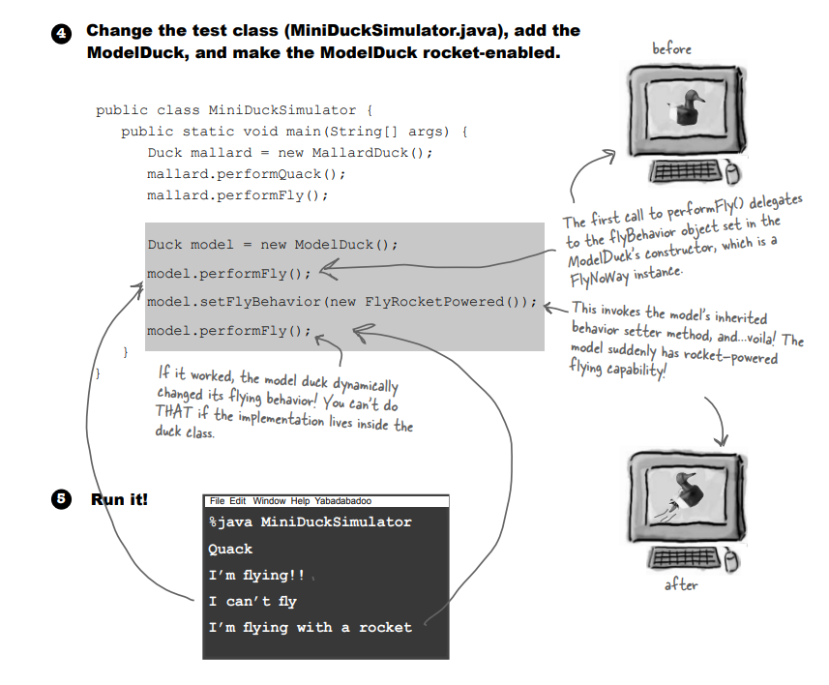

Slide 32
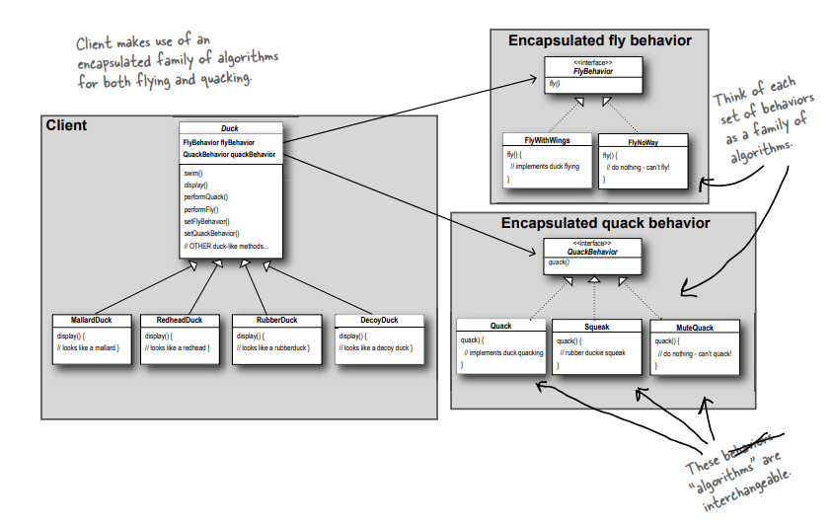
The Big Picture

Slide 33
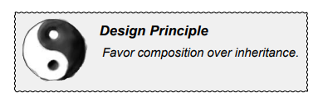
>
Has A
Is A
Main Advantage: Changing Behaviour in Runtime

Slide 34
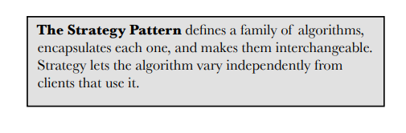
Formal Definition of the Design Pattern
Link: Code

Slide 35
Design Pattern, Helps?

Slide 36
Let’s say we are going to build a gateway for E-Commerce
Multiple Gateways
Different Clients
Different authentication process
Different Packages
….
What are the challenges:
CARDs
Mobile Banking
Credit Card
BKash
Nagad
Debit Card

Slide 37
Storage vs Communication among modules
Database/Storage: Is used to preserve the data only
But Database connection ? [Might require Singleton Pattern for single access point to reduce memory usage]
How Functions should communicate ? [Objects -> Application of Abstraction], e.g: Bkash System, Nagad System everything under MobileClient System. Objects with their hidden logic will propagate the feature of an application.
Does any feature corresponds to the specifics of a design pattern? If does, apply it.
Consider these logics as Algorithms: That would vary as per the context.

Slide 38
Thank You

